Slide 1
Waves on Transmission Lines
19th October 2020

Slide 2
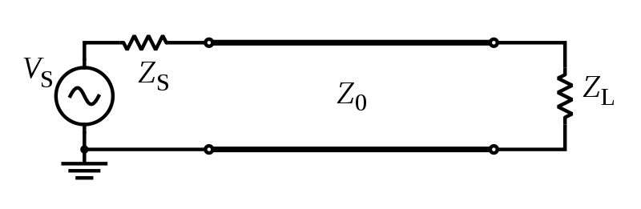
Transmission lines
A transmission line is used for the transmission of electrical power from generating substation to the various distribution units. It transmits the wave of voltage and current from one end to another.
Any transmission line can be simply represented by a pair of parallel wires into one end of which power is fed by an a.c. generator.
Transmission line
https://en.wikipedia.org/wiki/Transmission_line#/media/File:Transmission_line_symbols.svg
Notes:
Transmission power หมายถึง transmission ทั้ง voltage และ current

Slide 3
Wave equations for both voltage and current in a transmission line
In the deriving the wave equation, a short element of the line is considered.
Transmission line parameters are composed of resistance, inductance, conductance and capacitance.
The flowing currents gives rise to the combined inductance L₀ H per unit length.
Between the lines, which form a capacitor, there is an electrical capacitance C₀ F per unit length.
Resistance in the line is represented by R₀ Ω per unit length.
Conductance due to an imperfect insulating property of the insulator between the two conductors can be designated as G₀ S per unit length.

Slide 4
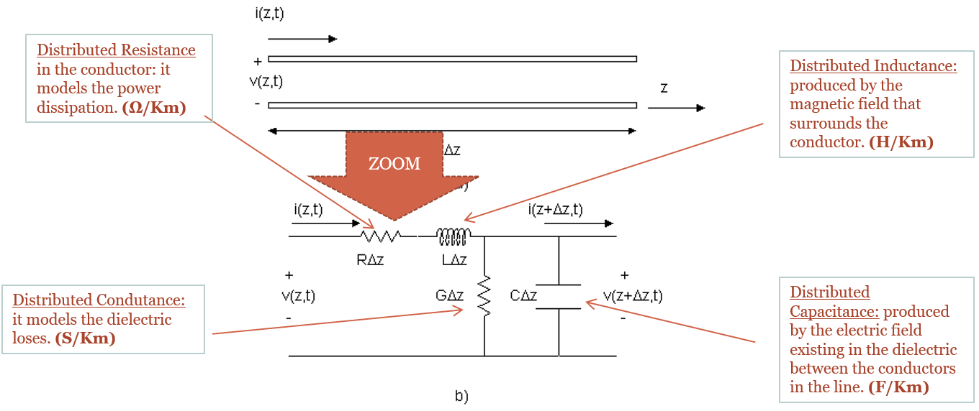
Distributed element in a transmission line
These parameters vary according to the type of line.
https://behindthesciences.com/microwaves-propagation/distributed-element-model-in-transmission-lines-part-ii/
Notes:
The distributed resistance {\displaystyle R} of the conductors is represented by a series resistor (expressed in ohms per unit length).
The distributed inductance {\displaystyle L} (due to the magnetic field around the wires, self-inductance, etc.) is represented by a series inductor (in henries per unit length).
The capacitance {\displaystyle C} between the two conductors is represented by a shunt capacitor (in farads per unit length).
The conductance {\displaystyle G} of the dielectric material separating the two conductors is represented by a shunt resistor between the signal wire and the return wire (in siemens per unit length).

Slide 5
Ideal or lossless transmission line
In the absence of any resistance and conductance; i.e. R₀ = G₀ =0, only L₀ and C₀ completely describe the line, which is known as ideal or lossless.
Representation of element of an ideal transmission line length dx.
The inductance of the element is L₀dx and capacitance of the element is C₀dx.

Slide 6
Derivation of the voltage and current waves
VOLTAGE WAVE EQUATION
If the rate of change of voltage per unit length at constant time is ∂V/∂x.
The voltage difference between the ends of the element dx is (∂V/∂x)dx, which is equals the voltage drop from the inductance -(L₀dx)∂I/∂t
Since ∂²/∂x∂t = ∂²/∂t∂x, a pure wave equation for the voltage with a velocity of propagation given by
v² = 1/L₀C₀ is
CURRENT WAVE EQUATION
If the rate of change of current per unit length at constant time is ∂I/∂x, there is a loss of current along the length dx of -(∂I/∂x)dx.
The loss is because some current has charged the capacitance C₀dx of the line to a voltage V.
If the amount of charge is q = (C₀dx)V,
So that
Since ∂²/∂x∂t = ∂²/∂t∂x, a pure wave equation for the current with a velocity of propagation given by
v² = 1/L₀C₀ is

Slide 7
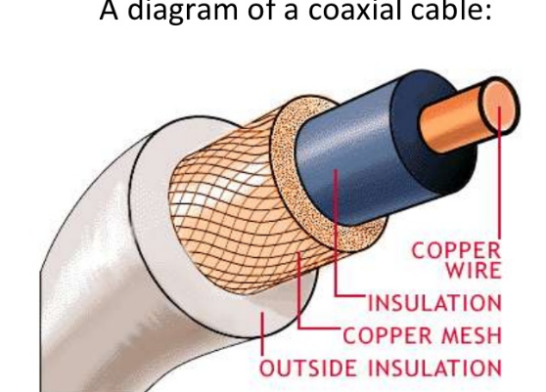
Coaxial cables
Many transmission lines are made in the form of coaxial cables.
The structure of the cables are composed of a cylinder of dielectric material having one conductor along its axis and the other surrounding its outer surface.
https://www.slideshare.net/tafadzwagonera/presentation-on-different-modes-of-data-communication

Slide 8
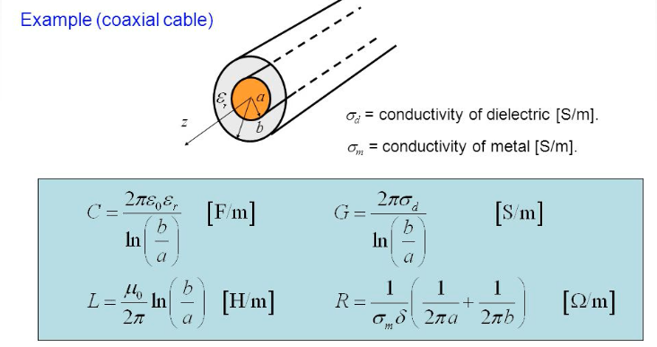
Inductance per unit length and conductance per unit length of coaxial cable
https://slideplayer.com/slide/1631556/

Slide 9
Characteristic impedance Z₀
The ratio of the voltage to the current in the waves travelling along the cable is
Z₀ is defined as the characteristic impedance if the impedance is seen by the waves moving down an infinitely long cable.
The impedance of the coaxial cable can be written as

Slide 10
Characteristic impedance of a transmission line (1)
Recall the wave equations of voltage and current waves
The solutions for travelling wave propagating in the positive direction are givens as
The voltage and current relates to each other via (∂V/∂x) = -(L₀)∂I/∂t: the voltage drops across an element length dx.
This gives
Both travelling waves are in phase.
“+” refers to a wave moving in the positive x-direction.

Slide 11
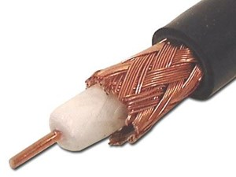
Example data sheet of coaxial cable RG 59/U
https://www.computercablestore.com/1000ft-rg-59u-coaxial-cable-75-ohm-shielded-riser-cmr

Slide 12
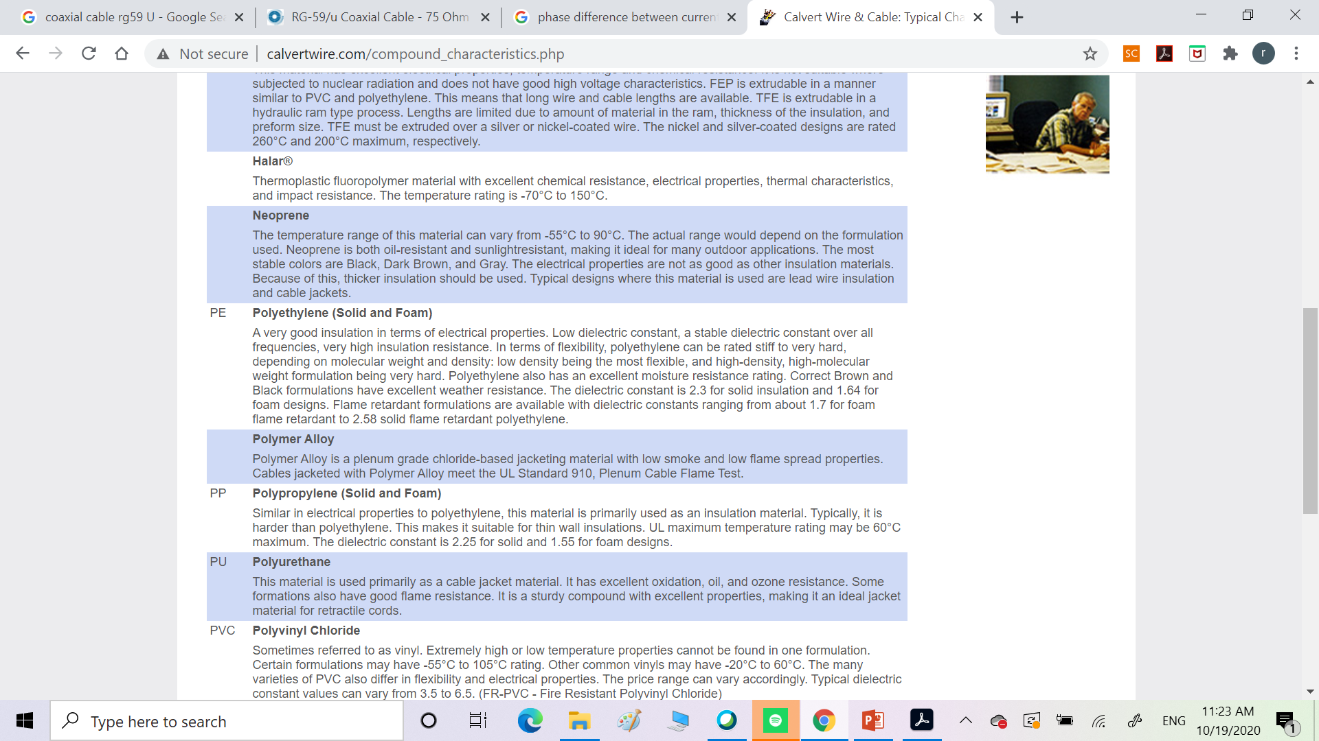
Key word :
foam PE dielectric constant

Slide 13
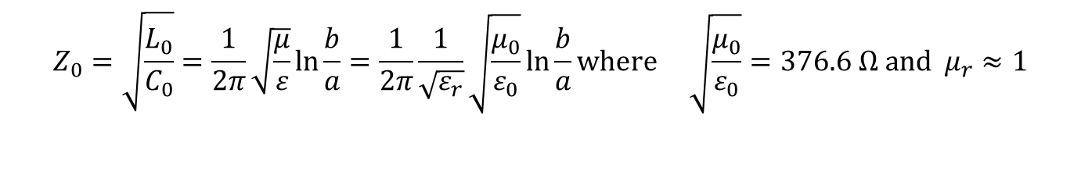
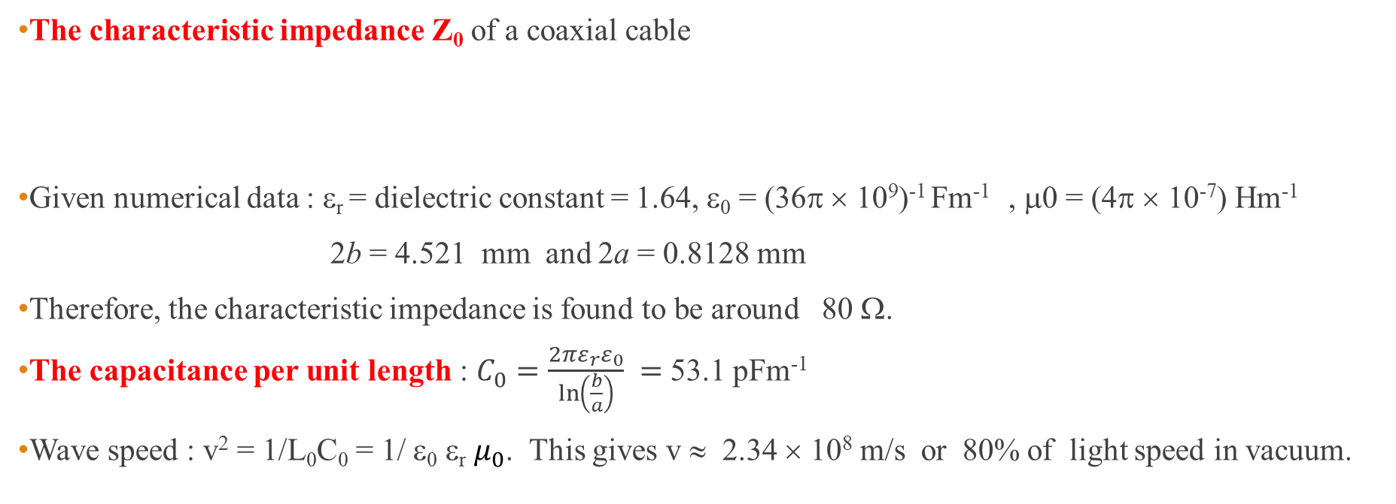
Calculation : Z₀, C₀ and wave speed
The characteristic impedance Z₀ of a coaxial cable
Given numerical data : ε_{r} = dielectric constant = 1.64, ε₀ = (36π × 10⁹)⁻¹ Fm⁻¹ , μ0 = (4π × 10⁻⁷) Hm⁻¹
2b = 4.521 mm and 2a = 0.8128 mm
Therefore, the characteristic impedance is found to be around 80 Ω.
The capacitance per unit length : $C_{0}=\frac{2πε_{r}ε_{0}}{\ln\left(\frac{b}{a}\right)} =$53.1 pFm⁻¹
Wave speed : v² = 1/L₀C₀ = 1/ ε₀ ε_{r} $μ_{0}$. This gives v ≈ 2.34 × 10⁸ m/s or 80% of light speed in vacuum.
$$Z_{0}=\sqrt{\frac{L_{0}}{C_{0}}}=\frac{1}{2π}\sqrt{\frac{μ}{ε}}\ln{\frac{b}{a}}=\frac{1}{2π}\frac{1}{\sqrt{ε_{r}}}\sqrt{\frac{μ_{0}}{ε_{0}}}\ln{\frac{b}{a}}\text{where} \sqrt{\frac{μ_{0}}{ε_{0}}}=376.6 Ω \text{and} μ_{r}≈1$$

Slide 14
Characteristic impedance of a transmission line (2)
Subsequently, this gives
The value of Z₀ for the coaxial cable is found to be
In common with the specific acoustic impedance, a negative sign is introduced to the ratio when the waves are travelling in the negative x-direction.
When waves are travelling in both directions along the transmission line, the total voltage and current at any point will be given by
Notes:
When a transmission line has waves only in the positive direction the voltage and current
waves are always in phase, energy is propagated and power is being fed into the line by the
generator at all times. This situation is destroyed when waves travel in both directions;
waves in the negative x-direction are produced by reflection at a boundary when a line is
terminated or mismatched;

Slide 15
Reflection from the end of a transmission line
Suppose that transmission line of characteristic impedance Z₀ has a finite length and that the end opposite that of the generator is terminated by a load of impedance Z_{L}.
Provided that the boundary condition at Z_{L} must be V₊+V₋ = V_{L}, where V_{L} is the voltage across the load and I₊+I₋ =I_{L}.
In addition, V₊/V₋ = Z₀, V₋/I₋ = -Z₀ and V_{L}/I_{L} = Z_{L}.
Travelling wave to the right
Travelling wave to the left

Slide 16
Voltage amplitude coefficient
Reflection coefficient
Transmission coefficient
Current amplitude coefficient
Reflection coefficient
Transmission coefficient
It is clear that if the line is terminated by a load Z_{L} = Z₀, its characteristic impedance, the line is matched, all the energy propagating down the line is absorbed and there is no reflected wave.

Slide 17
Derivation of the reflection coefficient
Starting with V₊+V₋ = V_{L} and I₊+I₋ =I_{L} , derive

Slide 18
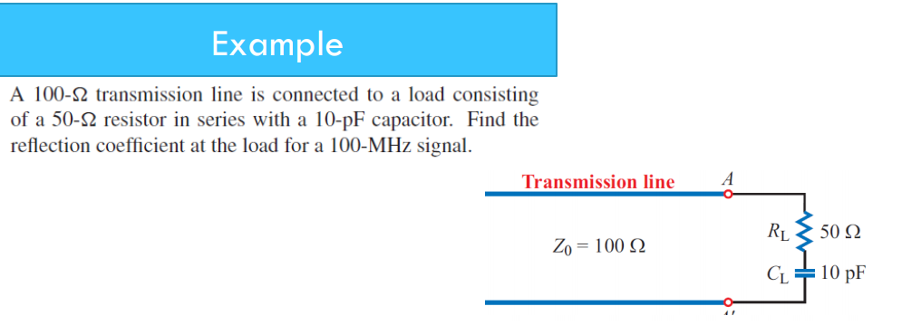
http://122.physics.ucdavis.edu/sites/default/files/files/Electronics/TransmissionLinesPart_II.pdf

Slide 19
Solution

Slide 20
Short circuited transmission line (Z_{L} = 0)
If the ends of the transmission line are short circuited, we have
This gives V+ = -V and there is total reflection with a phase change of π.
This is the condition for the existence of standing waves.
The figure shows that the voltage and current standing waves are out of phase in space by 90⁰.
In addition, both of them are also out of phase by 90⁰ in time.

Slide 21
Derivation of the voltage and current standing waves at any point along the transmission line.
At any position x on the line, the two voltage waves may be written as
With the total reflection and π phase shift, V₀₊ = -V₀₋,
The total voltage at x is
The total current at x is
Can you see the phase difference between voltage and current in space and time?
+ direction
- direction

Slide 22








Phase difference between current and voltage
$$V_{x}=\left(−i\right)2V_{0}e^{iωt}\sin{kx}$$
Recall total voltage and current at x :
Phase difference in space
Phase difference in time
$$I_{x}=2\frac{V_{0}}{Z}e^{iωt}\cos{kx}$$
$$V_{x}space=\sin{kx=\cos\left(kx−\frac{π}{2}\right)}$$
Current I leads voltage V by $\frac{π}{2}$.
$$I_{x}space=\cos{kx}$$
$$V_{x}time=−ie^{iωt}=e^{i\left(ωt−\frac{π}{2}\right)}$$
Current I still leads voltage V by $\frac{π}{2}$.
$I_{x}time=$ $e^{iωt}$

Slide 23
Effect of resistance in a transmission line
In practice, some resistance always exists in the wires which will be responsible for energy losses.
The transmission line is supposed to have a series resistance R₀ Ω per unit length and a short circuiting or shunting resistance between the wire.
The inverse shunt resistance is represented as a shunt conductance G₀ (siemens per meter).
Current will now leak across the transmission line because the dielectric is not perfect.
Real transmission line element includes a series resistance R₀ Ω per unit length and
a shunt conductance G₀ S per unit length

Slide 24
Travelling waves in a transmission line with resistance (1)
Recall the voltage and current changes across the line element length dx in case of lossless line,
Now, adding the resistance R₀ and conductance G₀ to the equation,
Inserting ∂/∂x into one of the above equation gives
Voltage drop across inductor
Voltage drop across resistor
Current drawn to capacitor
Attenuation or
absorption
coefficient
Current drawn to shunt resistor
Propagation constant
Wave number
Notes:
Voltage drops across inductor and resistor give rise to the reduction of the voltage in the transmission line element
Current flows through capacitor and shunt resistor causing the reduction of the current in the transmission line element.

Slide 25
Travelling waves in a transmission line with resistance (2)
Similarly, the differential equation for the current may written as
It is clear that the solutions for x-dependence of are of the form
The complete solution with the time-dependence term exp(iωt) may be written as
Amplitude attenuation terms of travelling waves caused by the resistance in the transmission line

Slide 26
Voltage and current waves in both directions along a transmission line with resistance.
The effect of the dissipation term is shown by the exponentially decaying wave in each direction.
Note that, the behavior of the current wave I is exactly similar.
Since power is the product VI, the power loss with distance varies as

Slide 27
Characteristic impedance of a transmission line with resistance
Let’s consider one of the solution to the equation ∂²I/∂x² = γ²I,
Recall , this leads to
Or
Similarly,
Notes:
The presence of the resistance term in the complex characteristic impedance means that power will be lost through Joule dissipation and the energy will be absorbed from the wave system.

Slide 28

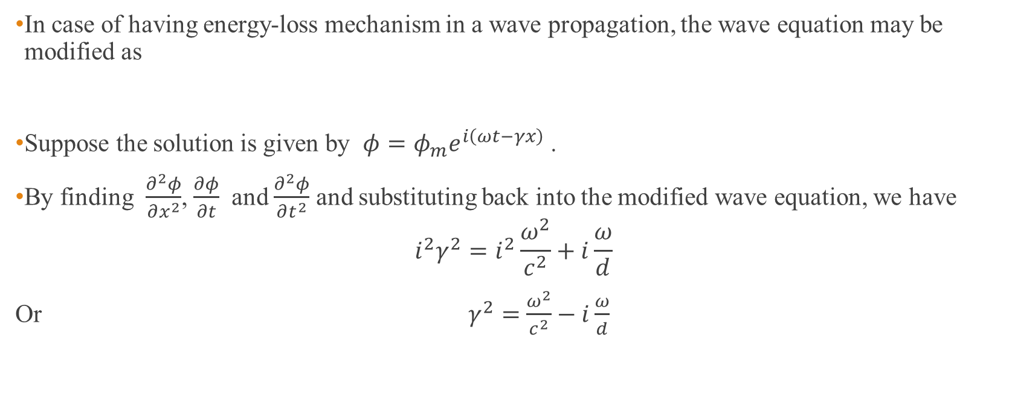
Wave equation with diffusion effects
In case of having energy-loss mechanism in a wave propagation, the wave equation may be modified as
Suppose the solution is given by $φ=φ_{m}e^{i\left(ωt−γx\right)}$ .
By finding $\frac{∂^{2}φ}{∂x^{2}}$, $\frac{∂φ}{∂t}$ and $\frac{∂^{2}φ}{∂t^{2}}$ and substituting back into the modified wave equation, we have
$$i^{2}γ^{2}=i^{2}\frac{ω^{2}}{c^{2}}+i\frac{ω}{d}$$
Or $γ^{2}=$ $\frac{ω^{2}}{c^{2}}−i\frac{ω}{d}$
$$\frac{∂^{2}φ}{∂x^{2}}=\frac{1}{c^{2}}\frac{∂^{2}φ}{∂t^{2}}+\frac{1}{d}\frac{∂φ}{∂t}$$
d = diffusivity with the dimension of length²/time

Slide 29
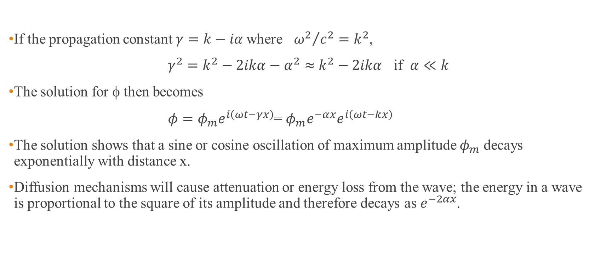
Wave equation with diffusion effects (contd.)
If the propagation constant $γ=k−iα$where ${ω^{2}}/{c^{2}}=k^{2}$,
$γ^{2}=k^{2}−2ikα−α^{2}≈$ $k^{2}−2ikα$ if $α≪k$
The solution for φ then becomes
$φ=φ_{m}e^{i\left(ωt−γx\right)}$= $φ_{m}e^{−αx}e^{i\left(ωt−kx\right)}$
The solution shows that a sine or cosine oscillation of maximum amplitude $φ_{m}$ decays exponentially with distance x.
Diffusion mechanisms will cause attenuation or energy loss from the wave; the energy in a wave is proportional to the square of its amplitude and therefore decays as $e^{−2αx}$.

Slide 30
Homework #8

